Slide 1
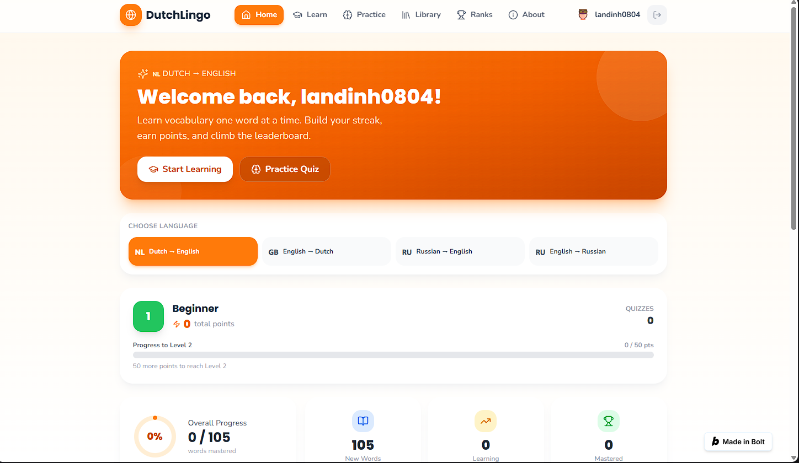
DutchLingo
Practical Dutch vocabulary for beginner learners
SDG 4 • Quality Education
Built with Bolt
Team: ____________________

Slide 2
The problem
A small but real everyday learning barrier
For international students and newcomers
Our SDG
SDG 4
• Practical Dutch helps with daily life in the Netherlands.
• Beginners need simple, regular vocabulary practice.
• Large language courses can feel difficult or expensive at the start.
Quality Education
DutchLingo gives beginner learners a low-pressure way to learn, practise, and revisit useful Dutch words.
DutchLingo • Hackathon presentation
2

Slide 3
Who is DutchLingo for?
Our first version has a clear, focused target group
Intended learners
Who we do not fully serve yet
• English-speaking adults who are new to Dutch
• International students and newcomers in the Netherlands
• Learners who need practical everyday vocabulary
• People with a device, internet access, and basic digital skills
• Learners without English literacy
• Offline users or people without a suitable device
• People needing more accessibility support
• Advanced learners needing detailed grammar or conversation practice
DutchLingo • Hackathon presentation
3

Slide 4
A simple learning journey
One app, four connected steps
1
2
3
4
Learn
Practise
Find
Track
See a Dutch word
and its translation
Answer quiz questions
and get instant feedback
Search the full
word library
See progress from
new to mastered
The prototype includes 105 curated Dutch–English words in 11 categories.
DutchLingo • Hackathon presentation
4

Slide 5
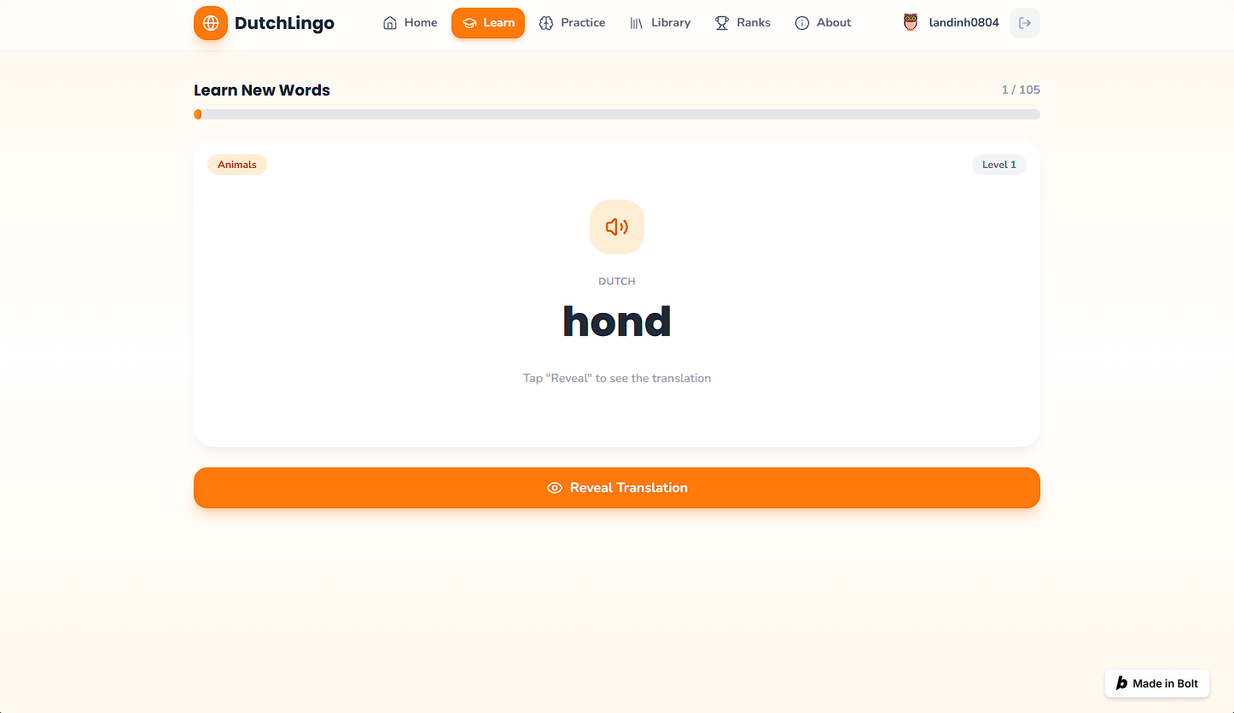
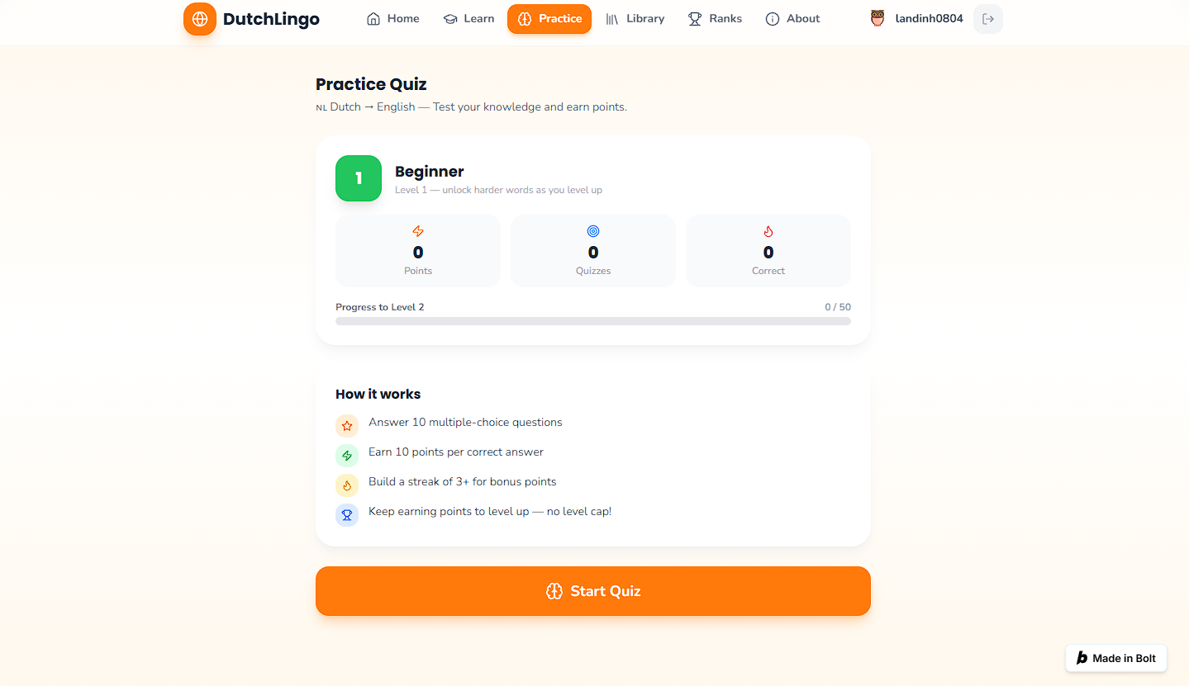
Learn and practise
Short activities make starting less overwhelming
Learn: reveal the translation when ready
Practice: quizzes, feedback, points and streaks
DutchLingo • Hackathon presentation
5

Slide 6
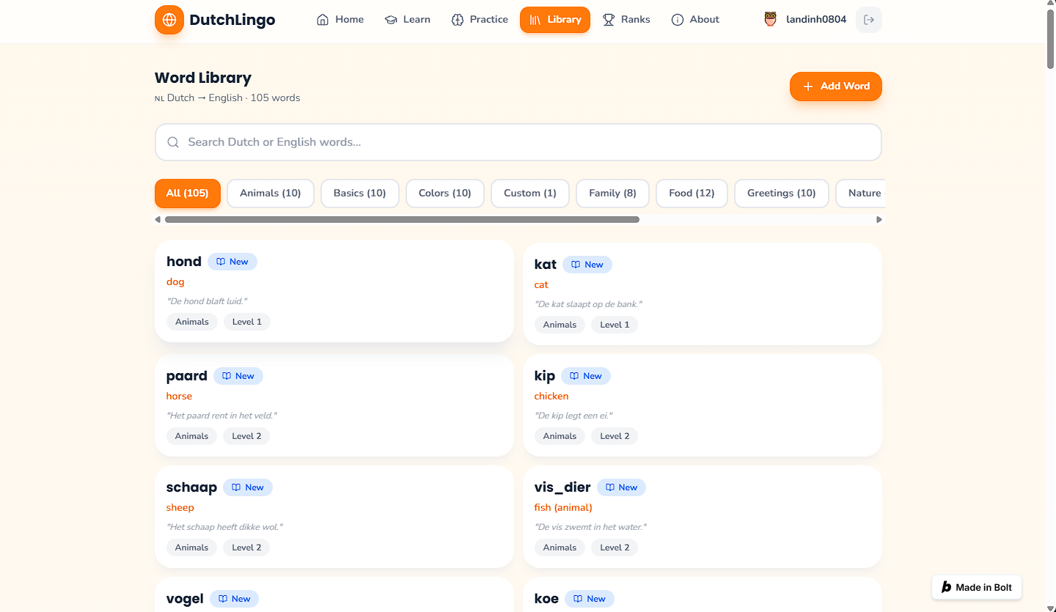
Find words and track progress
Learners can return to vocabulary whenever they need it
Search Dutch or English • browse categories • view examples
Dashboard shows words that are new, learning, and mastered
DutchLingo • Hackathon presentation
6

Slide 7
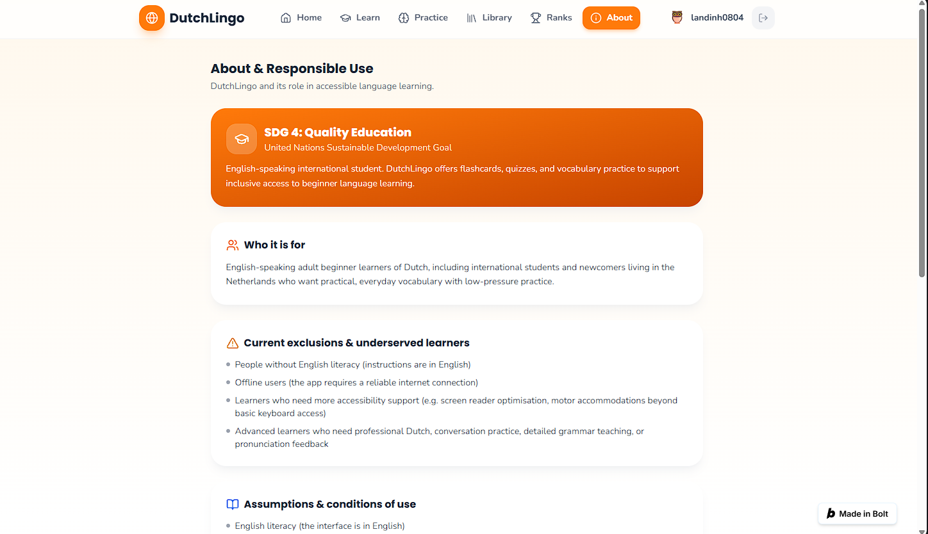
How we used Bolt responsibly
Bolt was the required AI tool in this hackathon
Bolt helped us to
• Build the React interface and learning screens
• Create and improve the app features
• Iterate on the design during the hackathon
• Solve issues and refine the prototype
Responsible use
Our team defined the problem, wrote prompts, reviewed the output, tested the app, and chose what to improve.
DutchLingo is a practice tool, not a language certificate or a tool for judging employment, education, migration, or integration.
DutchLingo • Hackathon presentation
7

Slide 8
Thank you
DutchLingo makes beginner Dutch practice simple, focused, and low-pressure.
Live demo
Questions?
• 1. Open Learn and show the word “hond”.
• 2. Reveal its English translation.
• 3. Open Practice and answer one quiz question.
• 4. Open Library and search for “hond”.
• 5. Open About and show SDG 4 and exclusions.
We are happy to explain our problem, our use of Bolt, and the prototype.
DutchLingo • Hackathon presentation
8

